Slide 1

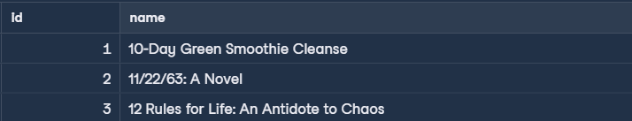
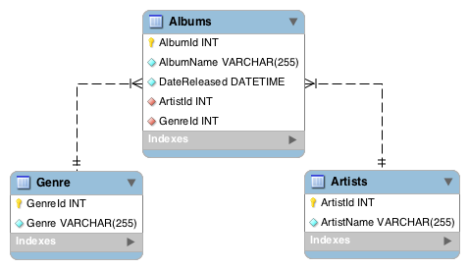
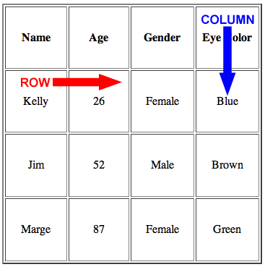
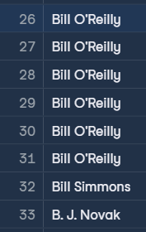
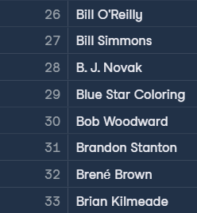


Data Types
Select limit number of records
Introduction to SQL
# Data Types change for database to another
Select the first (n) records
Main Types
String: sequence of characters such as letters, numbers(ASCII), or punctuation
Integers: store numbers
Floats: store fractional numbers
SELECT id, title AS name
FROM books
LIMIT 5;
SQL (Structured Query Language)
Aliasing
Programming language for communicating with data in database
Let us access, organize and analyze data with direct commands, known as queries
Schema
Rename columns in result set using keyword AS
Shows database’s design such as tables, relationships between tables and datatype of each field
SELECT id, title AS name
FROM books;
Table
Database consist of tables
Tables consist of rows (records) and columns (fields)
Rows contain individual data
Columns describe specific data
Unique values
SELECT author
FROM books;
SELECT DISTINCT author
FROM books;
Naming
Querying
Table
Query Main Keywords
Clear and refer to data
Lowercase
Use underscore not space
plural
# Used to Indicate what operations to perform
SELECT: which fields to be selected
FROM: indicates the table which these fields are located
employees – products_supplier
All fields using wildcard character (*)
SELECT *
FROM books;
Views
student – product supplier – st_pt
Saved SQL query acts like a virtual table
Select multiple fields
CREATE VIEW authors_publish_year AS
SELECT authors, year
FROM books;
Fields
SELECT author, title
FROM books;
Singular
Lowercase
Different to the table and other fields
NAME
names
Query from view as a normal table after creating
Select one field
name
Product_id
SELECT author
FROM books;
SELECT *
FROM authors_publish_year ;

